Slide 1
Computer Architecture
Seminar/Proseminar
Lecture 1a: Introduction and Logistics
A. Giray Yaglikci
27 April 2026

Slide 2
Goal of This Seminar/Proseminar
Strengthen your understanding of computer architecture
Teach/enable/empower you to:
  Think critically
  Think broadly
  Learn how to understand, analyze, and present papers and ideas
  Get familiar with key first steps in research
  Get familiar with key research directions

Slide 3
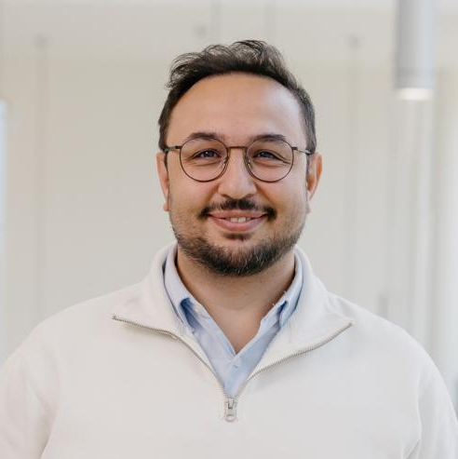
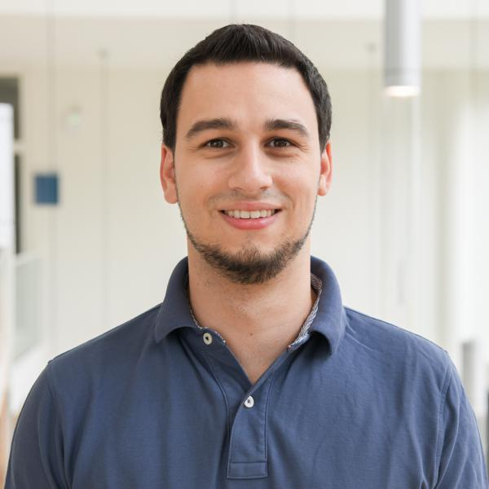




Teaching Team
Giray Yaglikci
Michael Schwarz
Eduard Ebert
Tristan Hornetz
Lorenz Hetterich
Namhun Kim

Slide 4
Computer Architecture
Achieving the highest efficiency, performance, and robustness
is possible via taking
the expanded view
Problem
Algorithm, Application
Programing Language, Compiler, Interpreter
System Software
Software / Hardware Interface
Microarchitecture
Logic
Devices
Physics
Computer Architecture
(expanded view)
Computer Architecture
(narrow view)

Slide 5
Computer Architecture
science and art of designing computing platforms
(hardware, interface, system SW, and programming model)
to achieve a set of design goals, e.g.,
  highest performance on earth on workloads X, Y, Z
  longest battery life at a form factor that fits in your pocket with cost < €€€
  the best performance/cost ratio
  data integrity
  confidentiality
  …
Designing a supercomputer is different from designing a smartphone
→ But, many fundamental principles are similar

Slide 6
Why Study Computer Architecture?
Enable better systems: faster, cheaper, smaller, more reliable, …
By leveraging advances and changes in underlying technology/circuits
Enable new applications and systems
  Life-like 3D visualization 20 years ago? Virtual reality?
  Self-driving cars?
  Personalized genomics? Personalized medicine?
Enable better solutions to problems
  Software innovation is built on trends and changes in computer architecture
  > 50% performance improvement per year has enabled this innovation
Understand why computers work the way they do

Slide 7
Computer Architecture Today
Today is a very exciting time to study computer architecture
Industry is in a large paradigm shift (to novel architectures) – many different potential system designs possible
Many difficult problems motivating and caused by the shift
  Huge hunger for data and new data-intensive applications
  Power/energy/thermal constraints
  Complexity of design
  Difficulties in technology scaling
  Memory bottleneck
  Reliability problems
  Programmability problems
  Security and privacy issues
No clear, definitive answers to these problems

Slide 8
Seminar/Proseminar in Computer Architecture
Fundamental and cutting-edge research papers in computer architecture
Multiple components that are aimed at improving students’
  technical skills in computer architecture
  critical thinking and analysis
  technical presentation of concepts and papers
    in both spoken and written forms
  familiarity with major research directions

Slide 9
How to Make the Best Out of This?
Come prepared → Read and critically evaluate the paper
Think new ideas
Bring discussion points and questions; read other papers
Be critical
Brainstorm – be open to new ideas
Pay attention and discuss + contribute
Participate online after each meeting

Slide 10
Anatomy of a Good Paper Review (Talk)
Title, Authors, Venue
Summary
  What is the problem the paper is trying to solve?
  What are the key ideas of the paper? Key insights?
  What are the key mechanisms? What is the implementation?
  What are the key results? Key conclusions?
Strengths (most important ones)
  Does the paper solve the problem well? Is it well written? …
Weaknesses (most important ones)
  This is where you should think critically. Every paper/idea has a weakness. This does not mean the paper is bad. It means that there is room for improvement and future research can accomplish this.
Thoughts/Ideas: Can you do better? Present your ideas.
Takeaways: What you learned/enjoyed/disliked? Why?
Discussion starters and questions

Slide 11
Paper Discussion Format
Problem & Goal
Key Ideas/Solution
Novelty
Mechanisms & Implementation
Major Results
Takeaways/Conclusions
Strengths
Weaknesses
The paper’s significance in the literature
New ideas/problems
Brainstorming and Discussion
~20 min Summary
~5 min Critique
~15 min Discussion

Slide 12
More Advice on Paper Review/Talk
When doing the paper reviews and analyses, be very critical
Always think about better ways of solving the problem or related problems
  Question the problem as well
  Read background papers (both past and future)
Critical thinking & analysis: This is how things progress in science
and engineering (or anywhere), and how you can make big leaps
Sample text reviews will be provided online

Slide 13
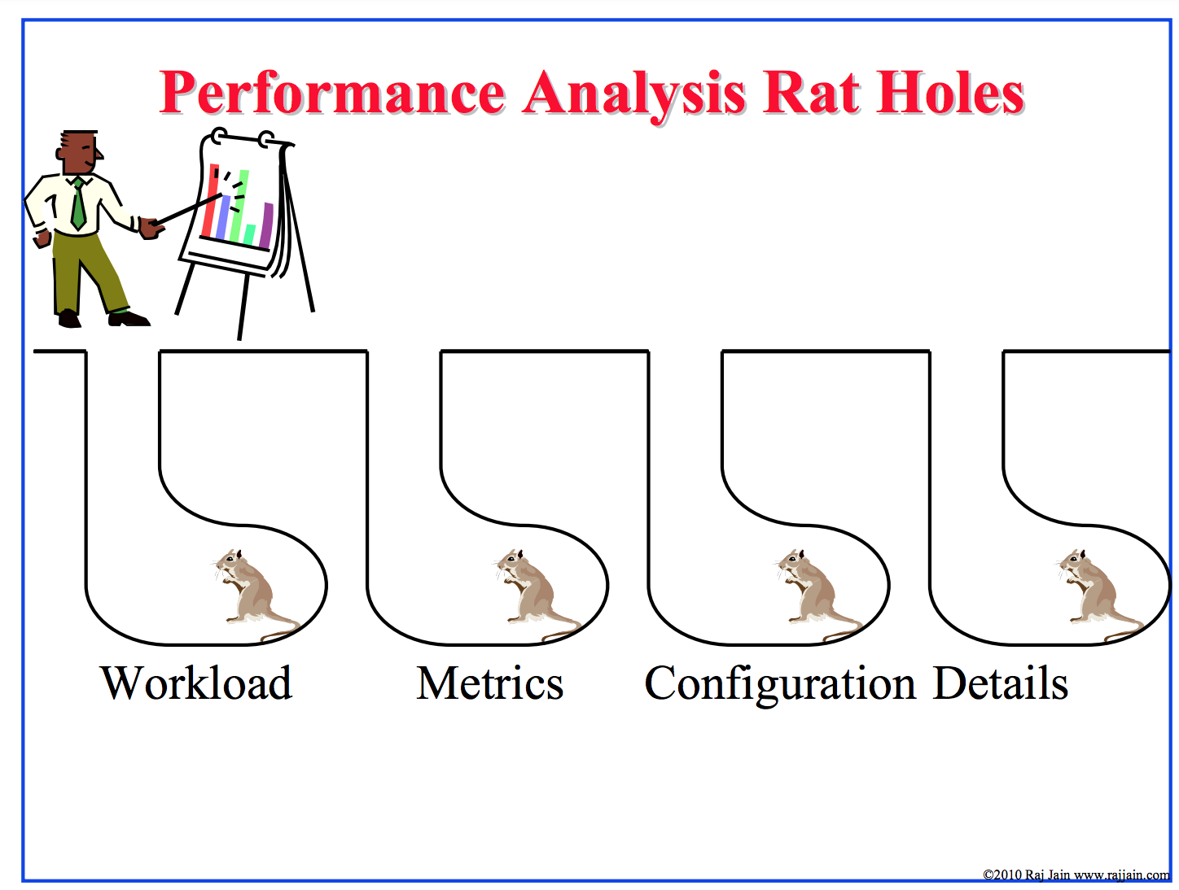
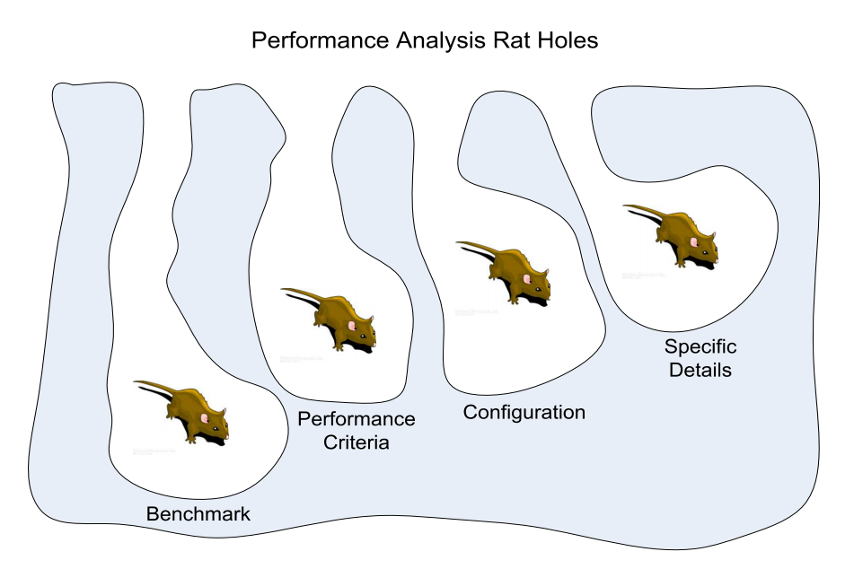
Avoid Rat Hole Discussions
Source: https://www.cse.wustl.edu/~jain/iucee/ftp/k_10adp.pdf
Source: P. Jarupunphol, “Using Buddhist Insights to Analyse the Cause of System Project Failures,” Ph.D. Thesis, 2013

Slide 14
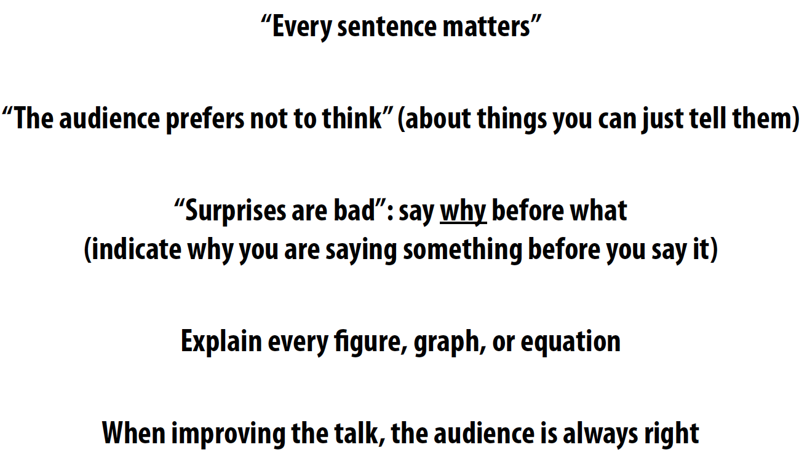
More Advice on Talks
Kayvon Fatahalian, “Tips for Giving Clear Talks”
  http://graphics.stanford.edu/~kayvonf/misc/cleartalktips.pdf
  Many useful and simple principles here

Slide 15
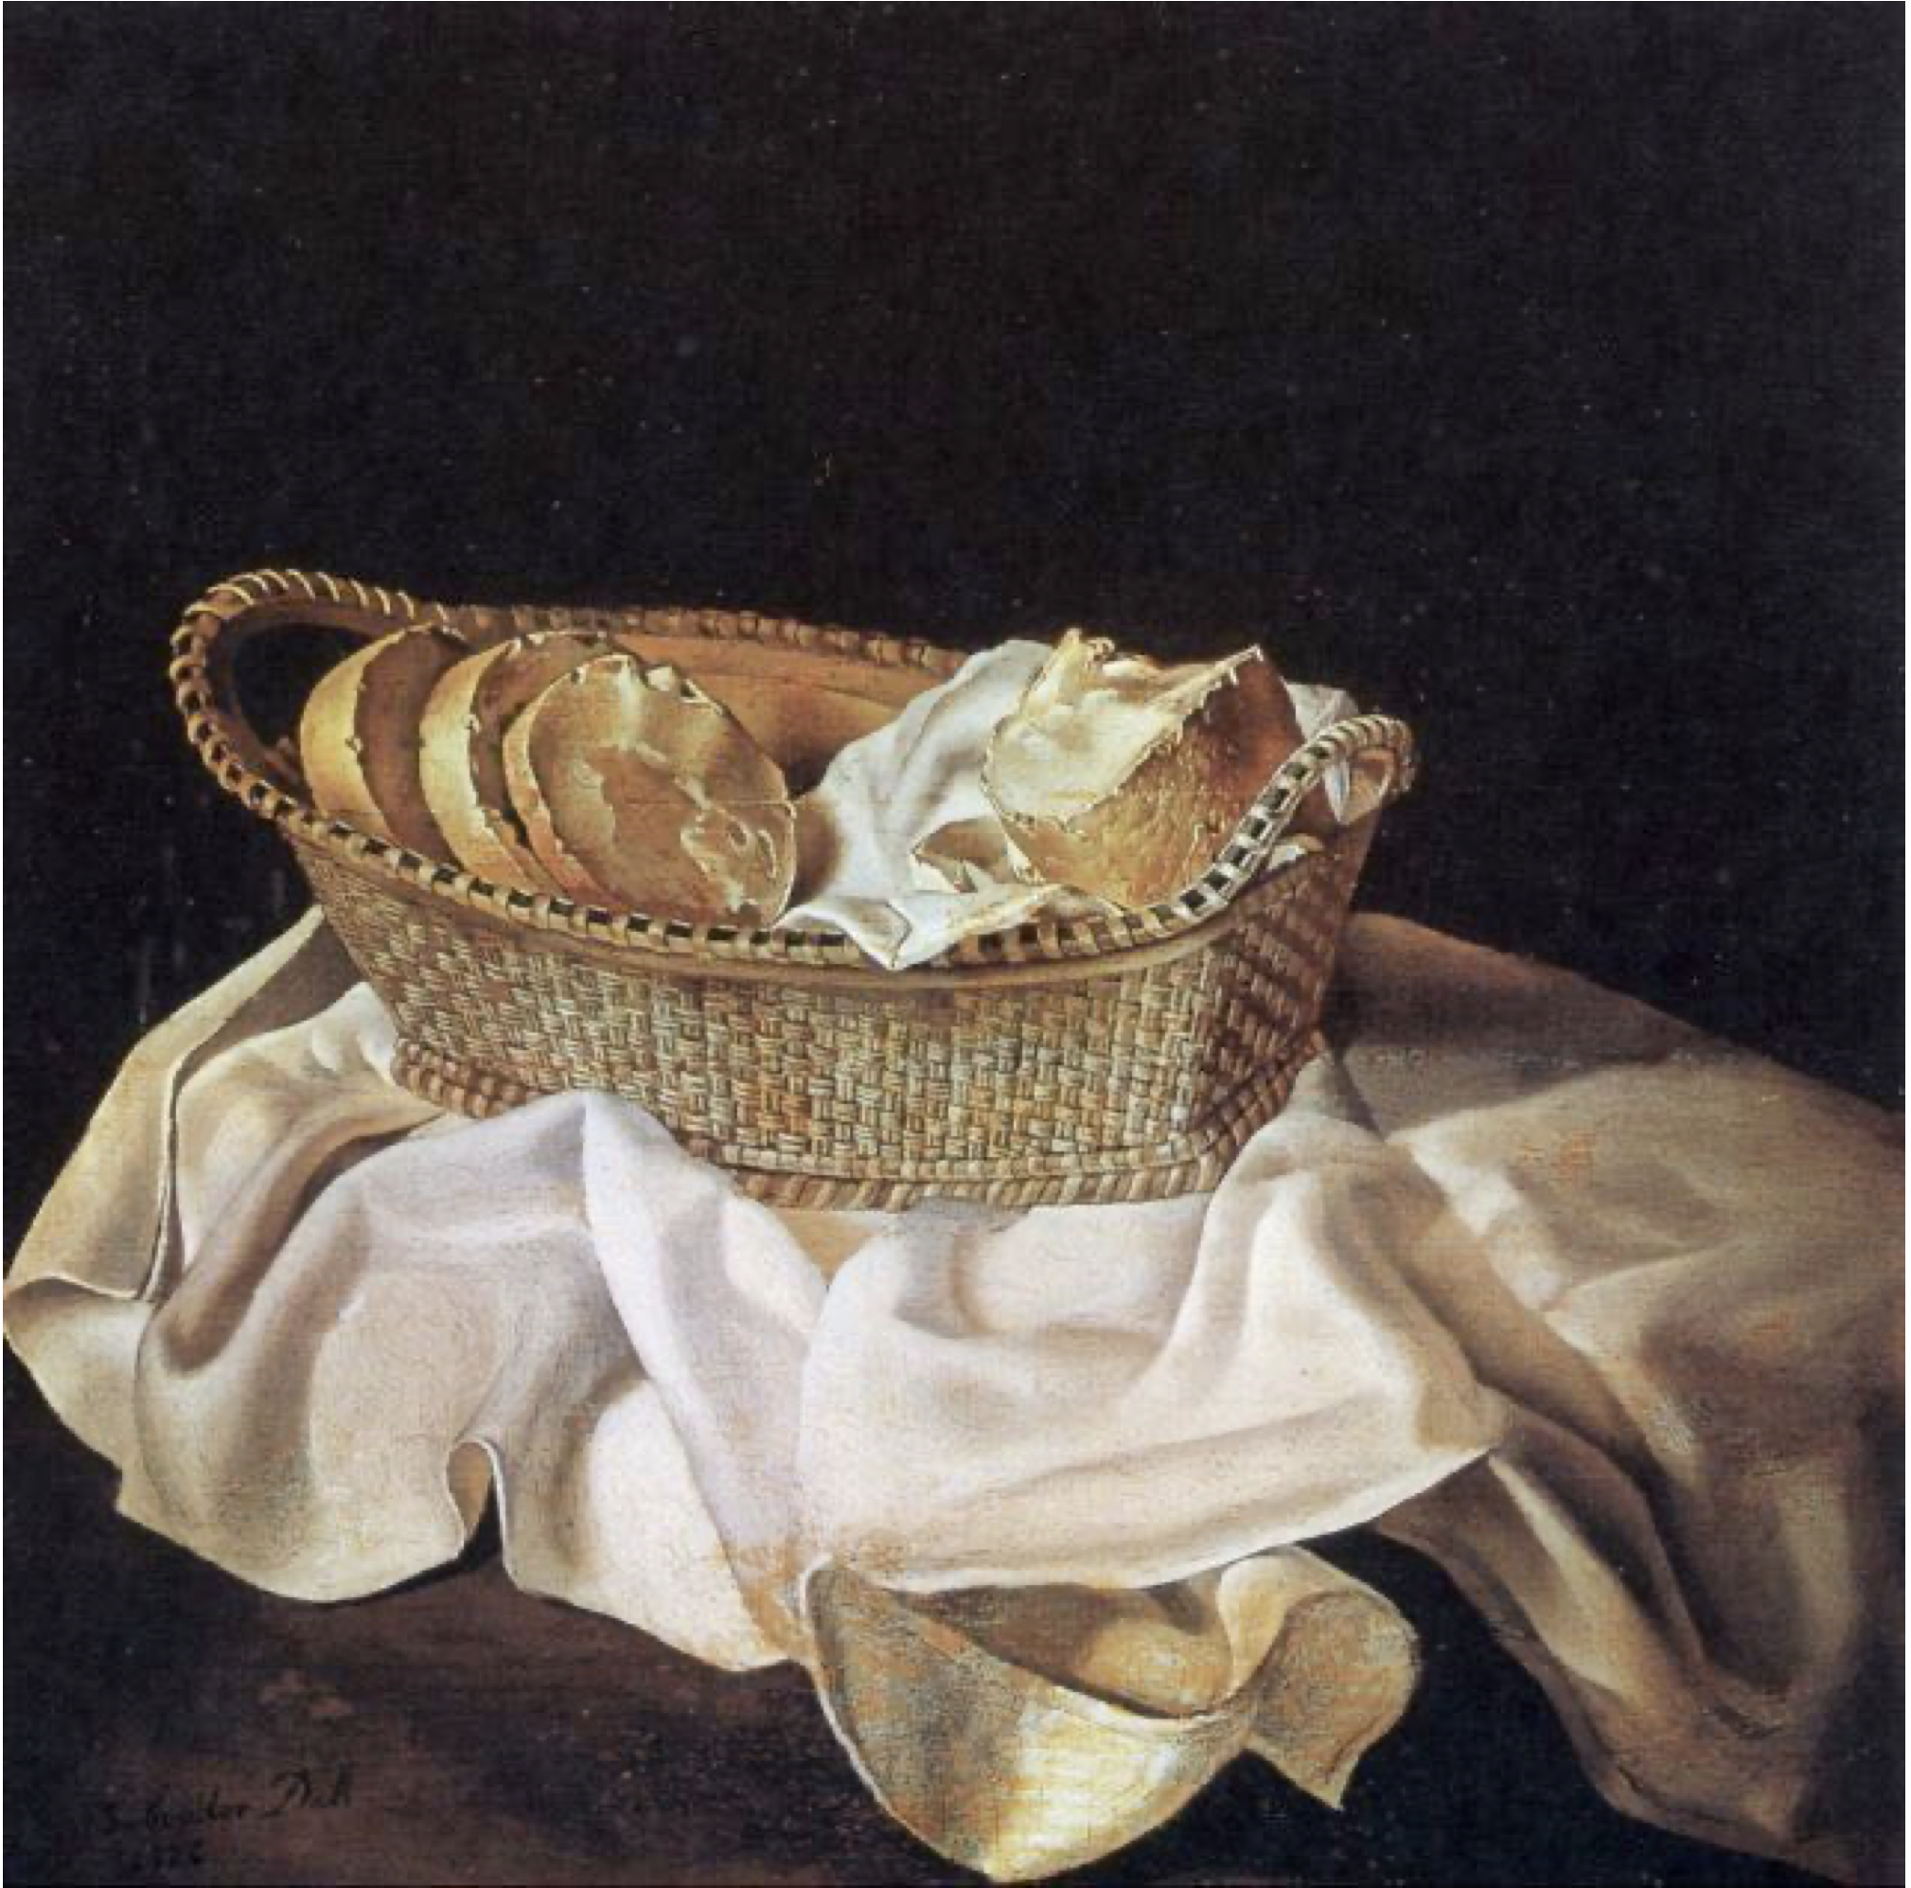
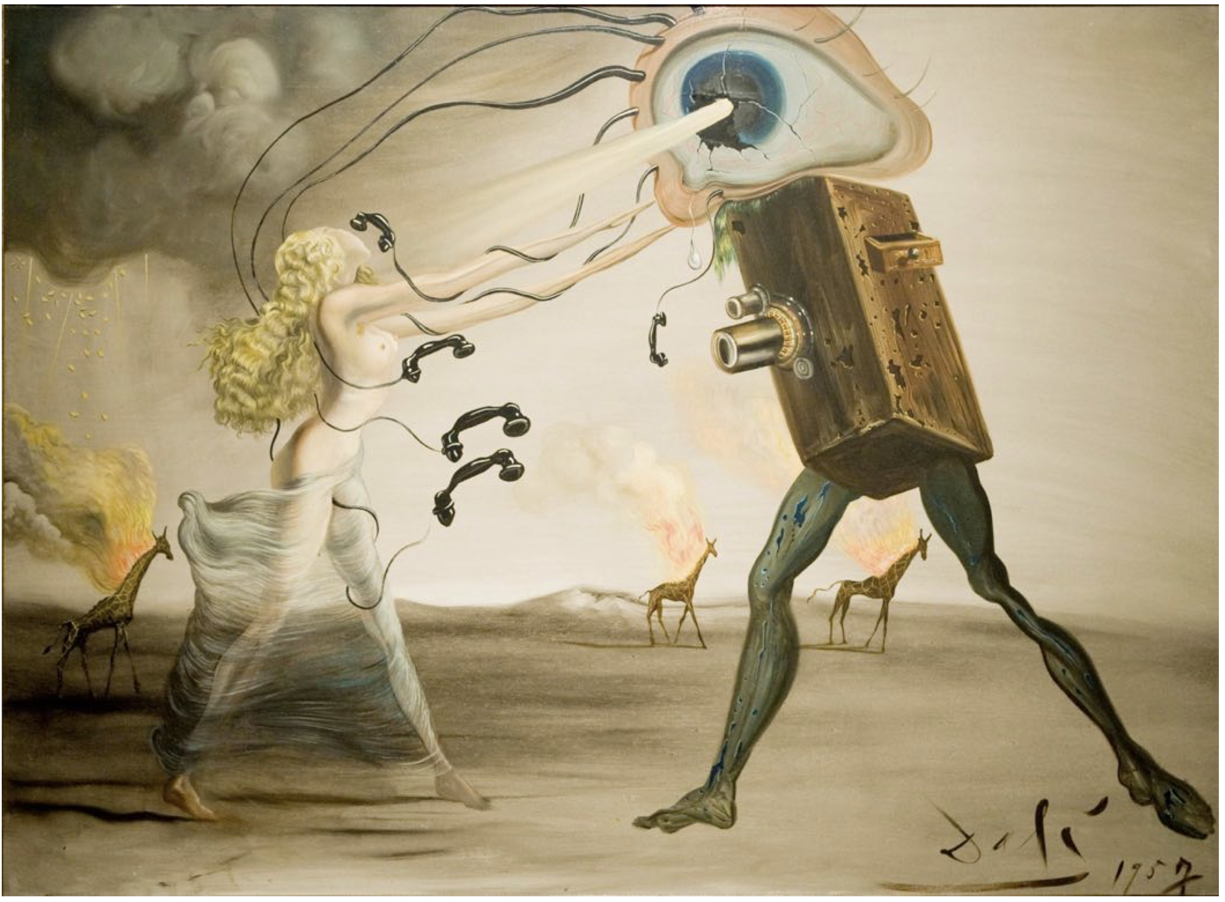
More Advice on Talks
Salvador Dali (age 22)
Salvador Dali (age 53)
Learn the basic principles before you consciously choose to break them

Slide 16
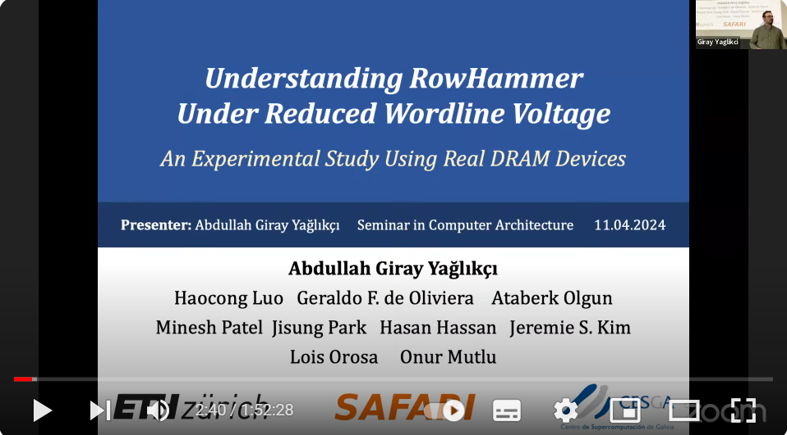

An Example Presentation and Discussion
Understanding RowHammer Under Reduced Wordline Voltage, DSN 2022
L7a: Seminar in Computer Architecture – Spring 2024,
[Talk Video] (60 min.)
[Slides (pptx) (pdf)]

Slide 17
Course Logistics and Grading

Slide 18
Three Deliverables
Critical Paper Review Talk
This is the paper that is assigned exclusively to you
Critical Paper Review Report
This is the paper that is assigned exclusively to you
Literature Survey
This focuses on a paper that is assigned exclusively to another classmate,
but contains all major related works relevant to the paper
and your projection to the future

Slide 19
Preparing Your Critical Paper Review Talk
Check your presentation date
Study your paper(s)
Create draft presentation
Meet advisor,
get feedback

Slide 20
Preparing Your Critical Paper Review Talk: Start Early
Preparing a good presentation takes time
Start early!
Check your presentation date
Study your paper(s)
Create draft presentation
Meet advisor,
get feedback

Slide 21
Preparing Your Critical Paper Review Talk: Study the Paper
3 ‘C’s of reading
  Carefully: look up terms, read cited papers
  Critically: find limitations, flaws
  Creatively: think of improvements
Try examples by hand and try tools if available
Study follow up works
Consult with mentors if questions
Check your presentation date
Study your paper(s)
Create draft presentation
Meet advisor,
get feedback

Slide 22
Preparing Your Critical Paper Review Talk: Prepare a Draft
Explain the motivation for the work
Clearly present the technical solution and results
  Include a demo if appropriate
Outline limitations or improvements
Focus on the key concepts
  Do not present all of the details
Check your presentation date
Study your paper(s)
Create draft presentation
Meet advisor,
get feedback

Slide 23
Preparing Your Critical Paper Review Talk: Get Feedback
Prepare for the meeting
  Schedule early
  Send slides in advance
  Write down questions
Make sure you address feedback
  Take notes
Meetings are mandatory!
  Latest: the week before the talk
  At least one meeting
Check your presentation date
Study your paper(s)
Create draft presentation
Meet advisor,
get feedback

Slide 24
Critical Paper Review Report
This is the critical review report of the paper you presented
Follows the same structure as your talk
Keep it concise
v1: Paper’s summary, your critique, and the discussion points.
Due: Mid-semester
v2: Built on v1 and elaborates on the discussion in and after the session

Slide 25
Literature Survey
This is the critical review report of a paper, presented by your classmate
Follows the same structure as your talk
Contains two more sections, each summarizing a number of other papers
  State-of-the-art before the presented paper
  State-of-the-art today and your projection into the future
Due: Two weeks before the last day of grade submission
This is compulsory only for the seminar students and bonus for everyone

Slide 26
Grading Rubric
 | Seminar | Proseminar
Presentation of the Critical Review | 40% | 50%
Active Participation in Discussion | 20% | 30%
Critical Paper Review Report | 10% | 20%
Literature Survey | 30% | 0%
Bonus: Literature Survey* | 10% | 10%
*
Collecting BONUS points is possible only if the student satisfactorily, participates in discussions and delivers
the compulsory materials (anything above the BONUS line in this table)

Slide 27
Tentative Schedule
Topics | 2003 | 2007 | 2011 | 2012 | 2014 | 2015 | 2016 | 2018 | 2019 | 2020 | 2021 | 2022 | 2023 | 2024 | 2025
CPU fuzzing |  |  |  |  |  |  |  |  |  |  |  |  |  | 2
DRAM Interface |  |  |  |  |  |  |  |  |  |  |  |  |  | 1
Memory Security |  | 1 |  |  |  |  |  | 1 |  | 1 |  |  | 2 |  | 3
Memory Reliability |  |  |  |  |  | 1 | 1
Processing near Memory |  |  |  |  |  | 1
Processing in Storage |  |  |  |  |  |  |  |  |  |  |  | 1
Processing Using Memory |  |  |  |  |  |  |  |  |  |  |  |  |  | 2 | 1
Secure caches |  |  |  |  |  |  |  |  | 1 |  |  |  | 1
Storage, privacy |  |  |  |  |  |  |  |  |  |  | 1
TEE |  |  |  |  |  |  | 1 |  |  | 1
uARch Energy |  |  | 1 | 1
uArch Security |  |  |  |  | 1 |  |  | 1 | 2 |  | 1 |  |  |  | 1
Speculative Execution | 1 |  |  |  |  |  |  |  |  |  |  | 1
We will meet once a week (except some weeks)
Two presentations per session (40 min. each)
Meeting time: Mondays 15:00 – 16:30
→ Starts at 15:00 sharp
Paper assignment
  Study the list of papers (https://cms.cispa.saarland/comparch_s26/2/Paper_List)
  All papers are uploaded (https://cms.cispa.saarland/comparch_s26/materials)
  Feel free to find and suggest a paper outside of this list
  Bid papers online (https://cms.cispa.saarland/comparch_s26/exams)
  Check your email and be responsive
  Assignment policy: First-Come-First-Served
  Due was May 4, but let’s pull it earlier to April 30 for early paper assignment and scheduling
  → More time for you to get prepared

Slide 28
Tentative Schedule
Week | Schedule | Important Dates | We will release | You will submit
April 22, 2026 | Release of the Paper List |  | Paper List
April 27, 2026 | Intro, Logistics, and Example Presentation | May 1: Labor Day
May 4-8, 2026 | Prep Week |  | Schedule of Sessions | Apr 30: Preferences
May 11, 2026 | Student Sessions | May 14: Ascension Day
May 18, 2026 | Student Sessions
May 25, 2026 | No class | May 25: Whit Monday |  | Report v1
June 1, 2026 | Student Sessions | Jun 4: Corpus Christi
June 8, 2026 | Student Sessions
June 15, 2026 | Student Sessions
June 22, 2026 | Student Sessions
June 29, 2026 | Student Sessions | ISCA Week
July 6, 2026 | Student Sessions | Euro S&P Week
July 13, 2026 |  |  |  | Report v2
Two weeks before the last day of grades |  |  |  | Literature Surveys
* All dates are subject to change

Slide 29
Policy for Using Artificial Intelligence (AI)
Rule of thumb: AI at your disposal is a tool and does not replace you
You are the sole author of the submitted and presented material
  You are responsible of every single word
  Hallucinations will not be tolerated
  You can be invited for an oral examination to test your knowledge of the submitted material
Using AI is ok
  for fixing your grammar and polishing your text
  for brainstorming if you fact-check every idea/statement/claim
When you use AI,
  Do not trust! Fact-check everything!
  Make sure that the terminology is correct
AI is great, but you are (should be) greater!
Technical depth of the final material should be more than what AI can generate by itself

Slide 30
Computer Architecture
Seminar/Proseminar
Lecture 1a: Introduction and Logistics
A. Giray Yaglikci
27 April 2026

